Slide 1

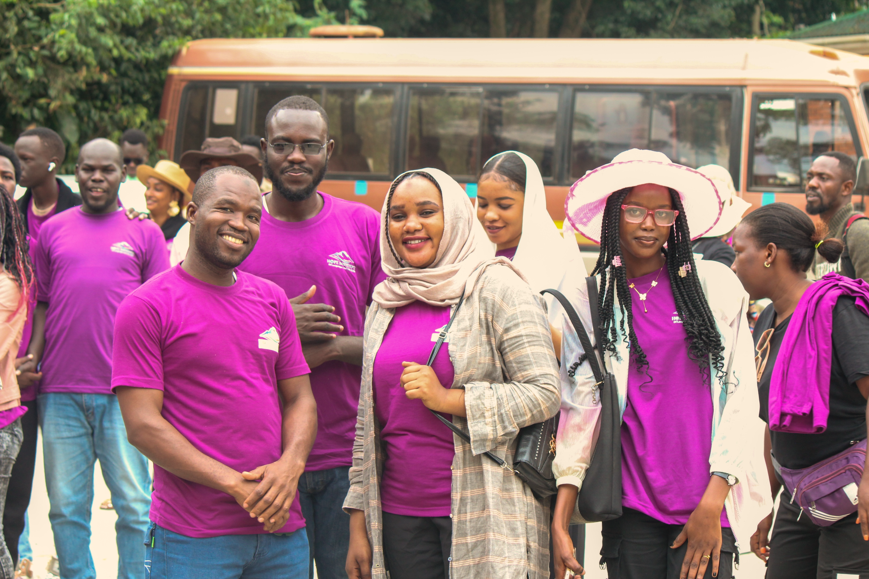




ABOUT US
OUR VISION
Hope Institute of Languages and Life Skills is a vocational institute based in Kansanga. We specialize in teaching English as a second language alongside a variety of practical trade skills designed to empower our students for success.
To create a safe and supportive learning environment with quality facilities that deliver a world-class educational experience.
OUR MISSION
To provide learners with hands-on skills, practical knowledge, and creativity to thrive in today’s job market.
Get In Touch:
For more information regarding intakes, interviews and our general services, fell free to reach out to us:
Mitala Road, Kansanga, Kampala, Uganda
Join us for professional vocational training and language mastery.
0767 935 988 | 0701 900 922
customerservice.hills@gmail.com
ADMISSIONS OPEN

Slide 2

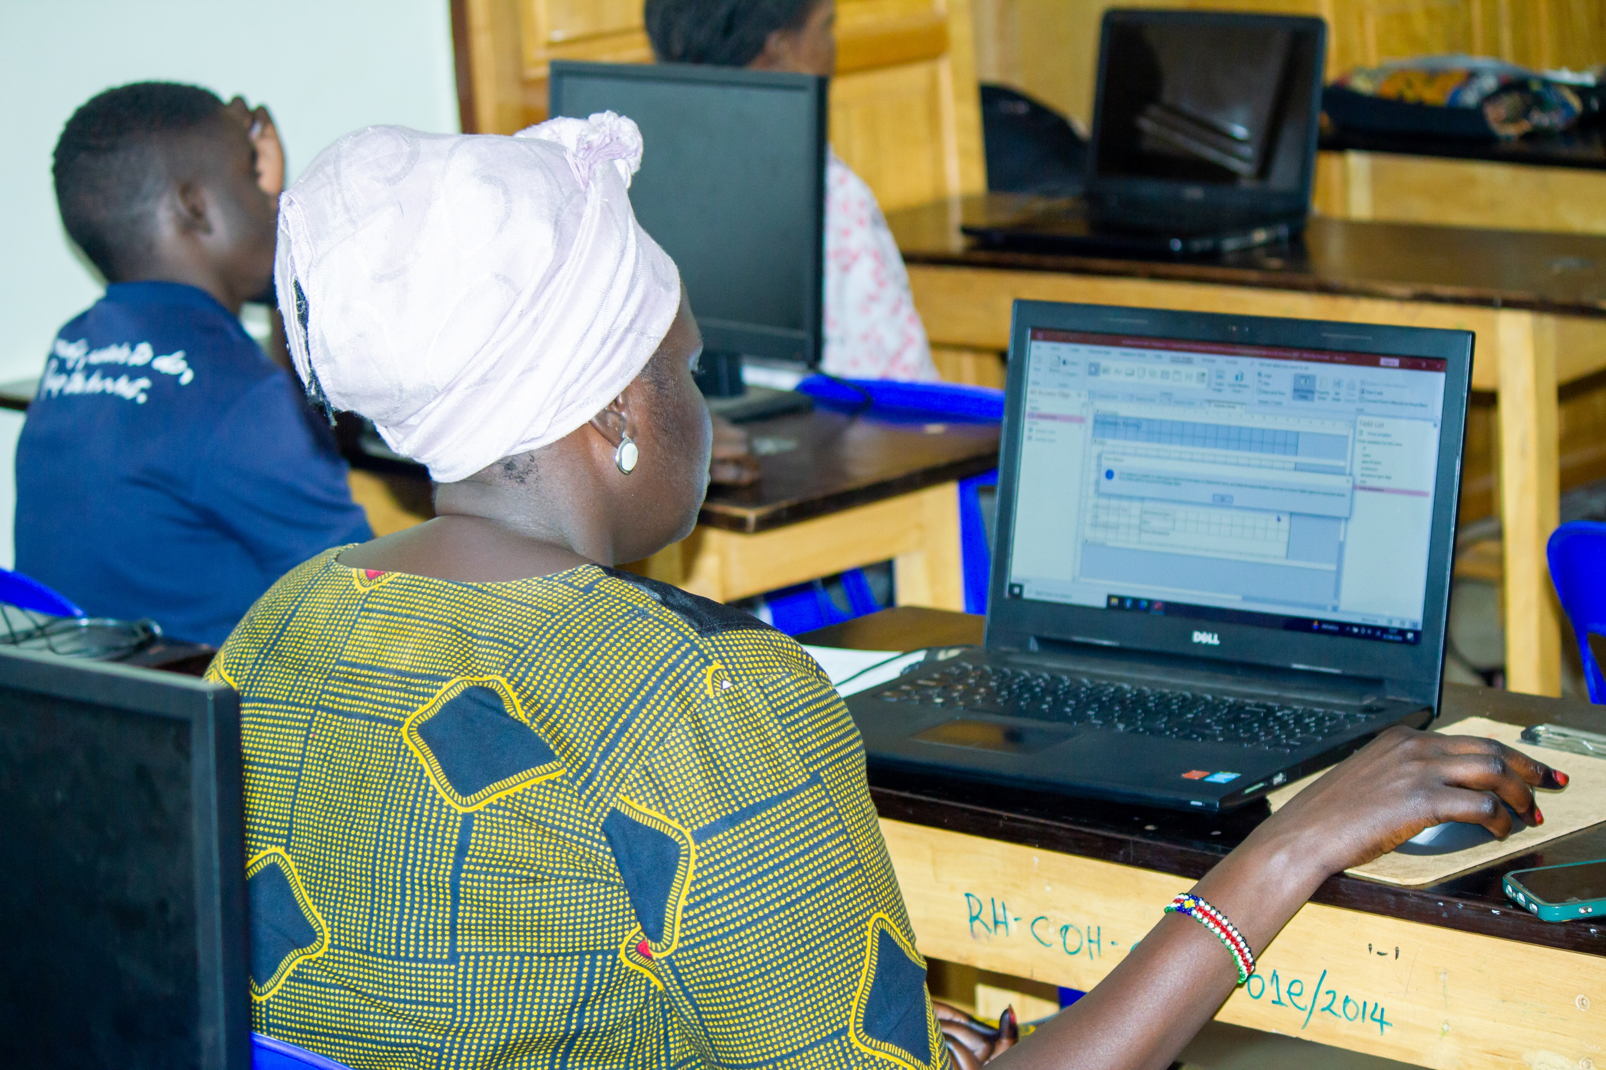
Why Choose Us?
Our Pathways
Skill/Product | Duration | Fees (UGX)
Bathing Soap | 5 Days | 100,000
Bar Soap | 5 Days | 70,000
Shower Gel | 4 Days | 50,000
Liquid Soap | 3 Days | 40,000
Hair Conditioner | 3 Days | 40,000
Hand/Dish Wash | 3 Days | 30,000
Hair Shampoo | 3 Days | 30,000
Bleach | 3 Days | 30,000
Practical Skills First: We focus on "Gifted Hands," ensuring every student masters their craft through 100% hands-on training.
Flexible Learning: Whether you prefer online sessions or physical classes in Kampala, we accommodate your busy schedule.
Entrepreneurship Focus: Start your own business in just 3 to 5 days with our intensive detergent production modules
Professional Certification: Earn a certificate upon completion to validate your skills for the job market or further studies.
Language & Academic Programs
IELTS Prep: Get ready for international study or migration with our 2-month intensive course.
Communicative English: Master the basics.
Business English: Professional communication training for the workplace.
Foreign Language: Enroll in French or Basic Arabic to expand your global reach.
Essential ICT Skills: Gain essential IT proficiency through our Computer Ordinary Level course.
Fees Structure
Program | Duration | Fees (UGX)
IELTS Exam Preparation | 2 Months | $200 USD
Communicative English | 1 Month | 150,000
Business English | Flexible/Modular | 150,000
French Language | 3 Months | 200,000
Essential ICT Skills | 3 Months | 350,000

